Slide 1

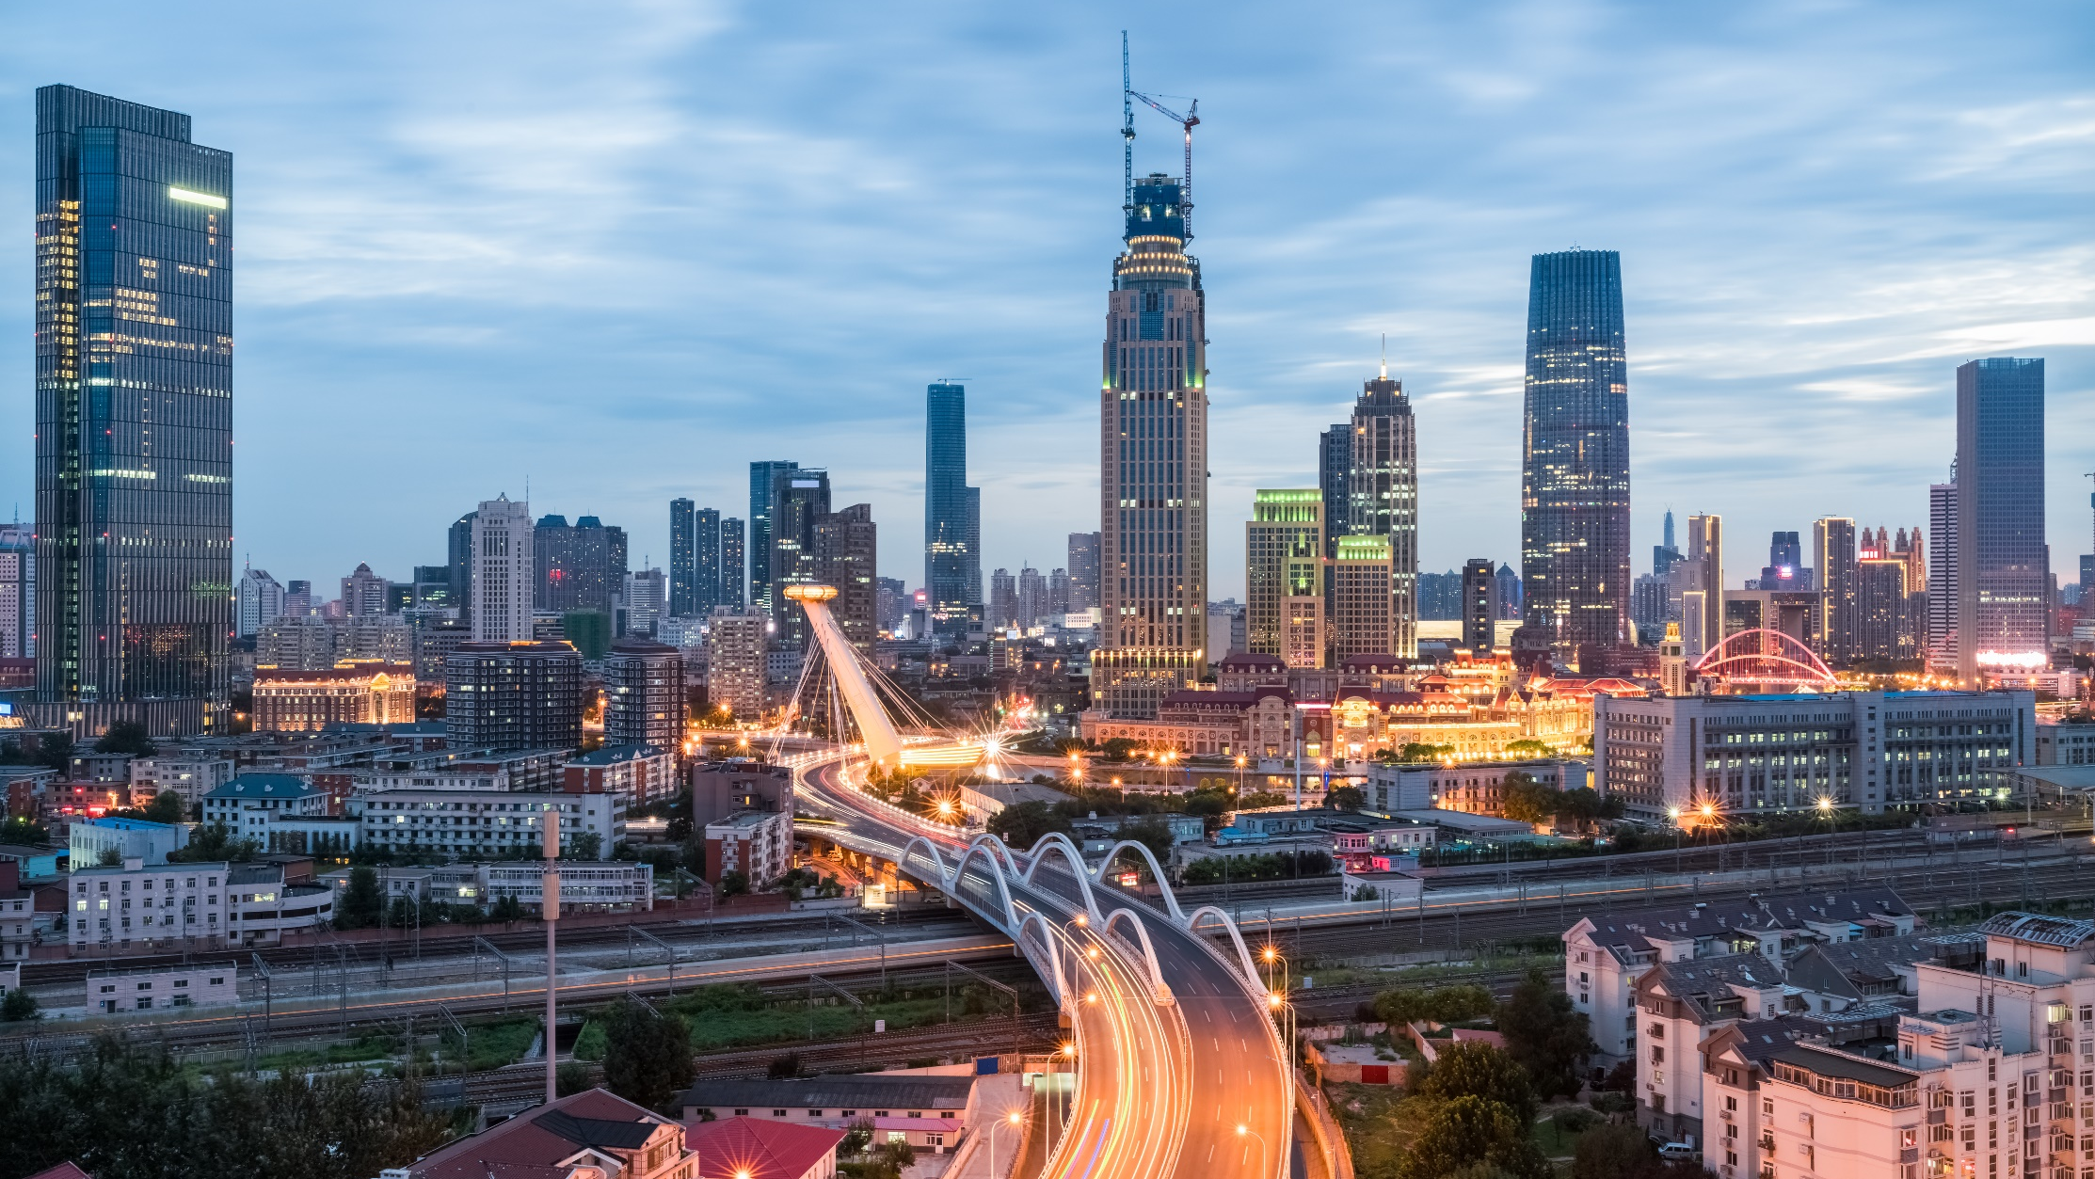
CÂU LẠC BỘ LẬP TRÌNH ỨNG DỤNG Ô TÔ
WELCOME TO OUR CLUB
BUILD YOUR CAREER WITH US!

Slide 2

X. TEMPLATE
Timeline (XX/XX-XX/XX)
12/08/2022
Jul., 2022
Aug., 2022
W26 | W27 | W28 | W29 | W30 | W31 | W32 | W33 | W34 | W35
1st meeting
[22nd June]
Study on FFT, PSD, related theory
Review meeting
Sensor and measurement technique research
Progress tracking
Back up
Read hardware’s datasheet and simulation setup
Programming Labview and sample value data acquisition
Final presentation
[17th August]
Final report – hard copy
[20th August]

Slide 3
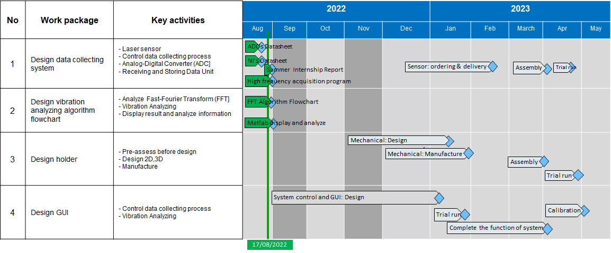
X. TEMPLATE
Schedule (XX/2022-XX/2023)
Finished
On-going
Extended

Slide 4

Thank you

